Slide 1

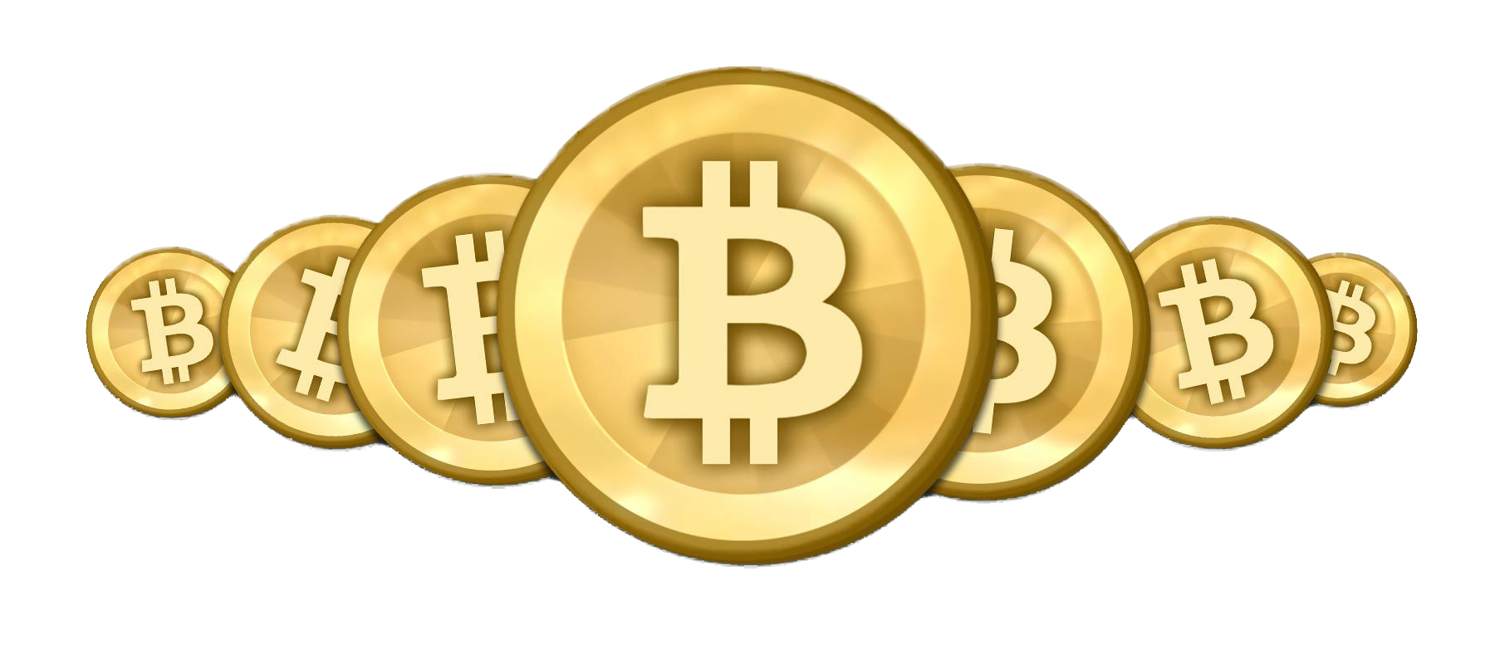
By: Daniel Gopal

Slide 2

What is Cryptocurrency ?
Digital currency or digital money is an Internet-based medium of exchange distinct from physical (such as banknotes and coins) that exhibits properties similar to physical currencies
allows for instantaneous transactions and borderless transfer-of-ownership.
• Cryptocurrency - A digital currency in which encryption techniques (cryptography) are used to regulate the generation of units of currency and verify the transfer of funds, operating independently of a central bank.
• The first cryptocurrency to be created was Bitcoin back in 2009. Today there are hundreds of other cryptocurrencies, often referred to as Altcoins.

Slide 3
What is Bitcoin
Bitcoin is a form of digital currency, created and held electronically
No one controls it. Bitcoins aren’t printed, like dollars or euros
They’re produced by people, and increasingly businesses, running computers all around the world, using software that solves mathematical problems.
It’s the first example of a growing category of money known as cryptocurrency.

Slide 4
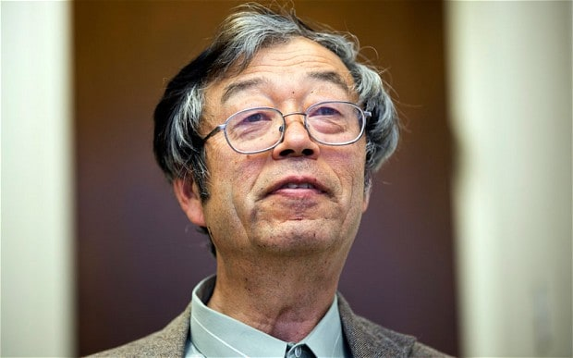
How was it created?
A software developer called Satoshi Nakamoto proposed bitcoin, which was an electronic payment system based on mathematical proof. The idea was to produce a currency independent of any central authority, transferable electronically, more or less instantly, with very low transaction fees.

Slide 5
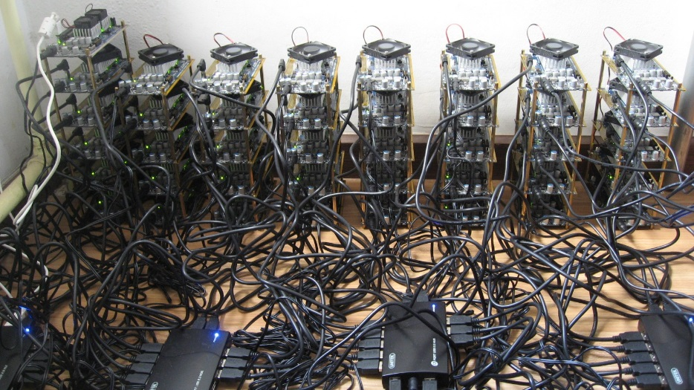
How it is made?
This currency isn’t physically printed by a central bank. Some argue central banks are unaccountable to the population and can simply produce more money to cover the national debt, thus devaluing their currency.
Instead, bitcoin is created digitally, by a community of people anyone can join. Bitcoins are ‘mined’, using computing power in a distributed network.
This network also processes transactions made with the virtual currency, effectively making bitcoin its own payment network.

Slide 6
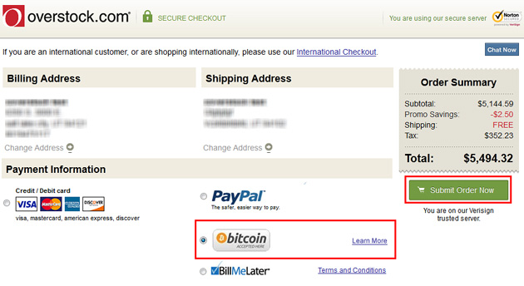
What has Bitcoin become
Bitcoin has attracted a lot of attention by people
One of the possibilities of the system is that it or a similar open-architecture payment network may provide a cheaper method for businesses to receive payments than the Visa and MasterCard systems.
Websites such as Overstock.com has started accepting Bitcoins and states that its processing costs for receiving payments in Bitcoin are lower than for traditional credit cards

Slide 7

Facts about Bitcoin
Currency of the future.
1. Send bitcoin from your computer, tablet, smart phone or other device, to anyone, anywhere in the world, day or night
2. Bitcoin verifies transactions with the same encryption used in banking, military and government applications
3. Bitcoin is open-source. Nobody owns it; the most popular client is maintained by a community of open-source developers
4. Using the Bitcoin network is free, except for a voluntary fee you can use to speed up transaction processing.
5. Bitcoin transactions are not secret. In order to be verified by the network of miners, they need to be published to the network.

Slide 8
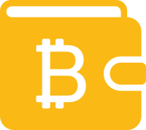
Why should you use bitcoins ?
Bitcoins are transferred directly from person to person via the net without going through a bank or clearinghouse.
They are fast and cheap
People can’t steal your payment information from merchants It isn’t inflationary It’s as private as you want it to be You don’t need to trust anyone else You own it You can create your own money simply mine it
Secured by collective compute power of miners and is very difficult to make changes but easy to verify

Slide 9

Why you shouldn’t use Bitcoin?
There is no buyer protection as when goods are bought using Bitcoins, and if the seller doesn’t send the goods, nothing can be done to reverse the transaction.
Wallets/Transactions Can Be Lost If a hard drive crashes, or a virus corrupts data. As when the wallet file is corrupted, Bitcoins have essentially been lost. There is nothing that can done to recover it. These coins will be forever gone in the system. The coins the investor owned will also be permanently gone.
There are a lot of risk on unknown technical flaws as this is a fairly new system

Slide 10
Thanks
For Listening

